Slide 1
Decision Tree and Random Forest
Alaka Krishnan R.U
Software Engineer,Language Technology
ICFOSS, Trivandrum

Slide 2
Agenda
What is classification?
What is Decision tree?
Visualizing decision tree
Terminologies associated with decision tree
Random Forest algorithm
Visualising Random Forest
Hands-on session

Slide 3
Decision tree
Decision Trees (DTs) are a non-parametric supervised learning method used for classification and regression.
The goal is to create a model that predicts the value of a target variable by learning simple decision rules inferred from the data features
Graphical representation of all possible solution to a decision
From the root it keeps on branching based on the number of decisions
Root node, Internal nodes, leaf node, branches/sub nodes
Reach the leaf node process ends class label assign to it.

Slide 4
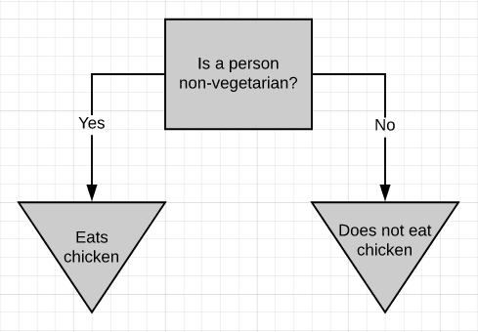
What are Decision trees?
Yes/No

Slide 5
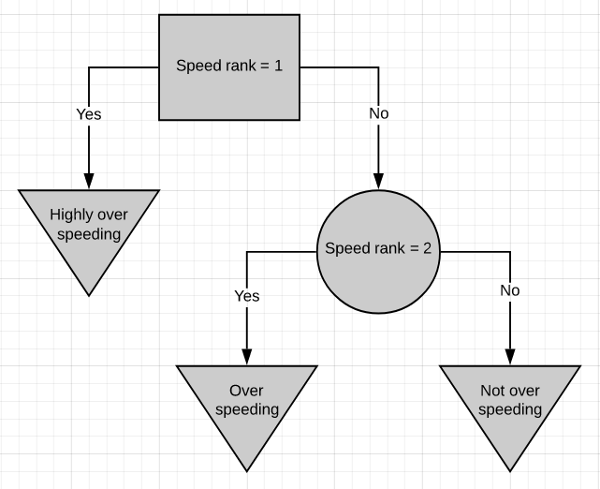
On Rank Based..

Slide 6
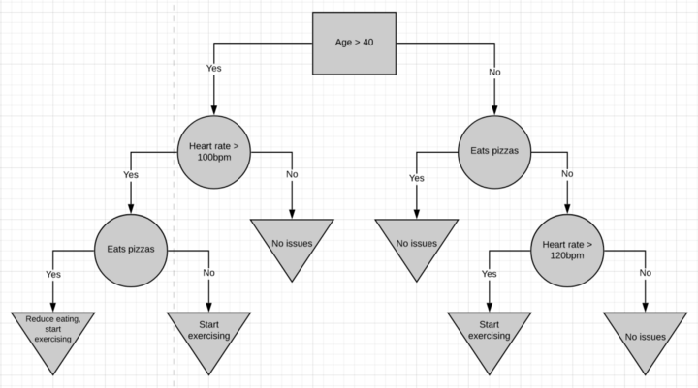
Combines numeric & yes/no data

Slide 7
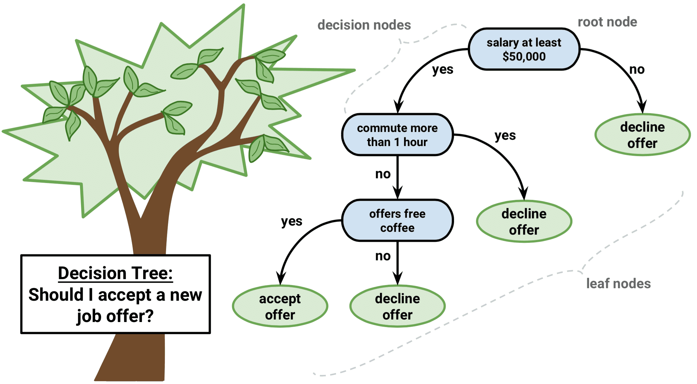
Visualization of DT

Slide 8
CART
DT algorithm that produces binary Classification or Regression Trees.
Depending on whether the dependent (or target) variable is categorical or numeric, respectively.
Same variables can use more than once in different parts of the same DT

Slide 9
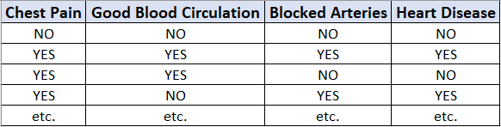

Slide 10
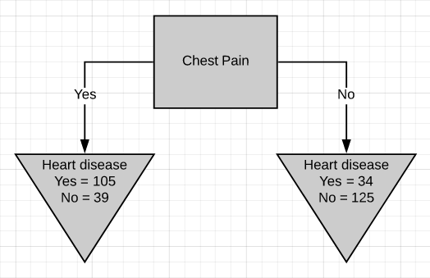
Chest pain as the root node

Slide 11
Calculate Gini Impurity Score
The metric used in the CART algorithm to measure impurity is the Gini impurity score
Probability for the left node.
Gini impurity = 1 - (probability of ‘yes’)² - (probability of ‘no’)²
= 1 - (105/105+39)² - (39/105+39)²
  Gini impurity = 0.395
Probabiltiy for the right node
Gini impurity = 1 - (probability of ‘yes’)² - (probability of ‘no’)² = 1 - (34/34+125)² - (125/34+125)²
  Gini impurity = 0.336

Slide 12
The leaf nodes do not represent the same no. of patients as the left
leaf represents 144 patients and the right leaf represents 159 patients.
Thus the total Gini impurity will be the weighted average of the leaf node Gini impurities.
Gini impurity = (144/144+159)*0.395 + (159/144+159)*0.336
= 0.364
Gini impurity for ‘good blood circulation’ = 0.360
Gini impurity for ‘blocked arteries’ = 0.381

Slide 13
Terminologies
Entropy : Measure of impurity or randomness
Information gain: Measures reduction in entropy. Decides which feature should be selected as decision node.
Pruning: cutting down the nodes to get the optimal solution

Slide 14
Entropy
Entropy(s)= -P(yes)log2 P(yes)- P(no) log2 P(no)
Where,
S= Total number of samples
P(yes)= probability of yes
P(no)= probability of no

Slide 15
Information gain
It calculates how much information a feature provides us about a class.
According to the value of information gain,split the node and build the decision tree.
A node/attribute having the highest information gain is split first.
Information Gain= Entropy(S)- [(Weighted Avg) *Entropy(each feature)]

Slide 16
Pruning
Pruning is a process of deleting the unnecessary nodes from a tree in order to get the optimal decision tree.
A too-large tree increases the risk of overfitting
Small tree may not capture all the important features of the dataset.
Therefore, a technique that decreases the size of the learning tree without reducing accuracy is known as Pruning.

Slide 17
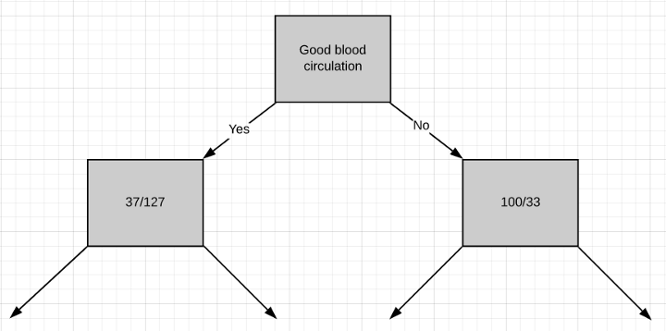
‘Good blood circulation’ has the lowest impurity score among the tree which symbolizes that it best separates the patients having and not having heart disease, so we will use it at the root node.

Slide 18
Algorithm
Step-1: Begin the tree with the root node, says S, which contains the complete dataset.
Step-2: Find the best attribute in the dataset using Attribute Selection Measure (ASM).
Step-3: Divide the S into subsets that contains possible values for the best attributes.
Step-4: Generate the decision tree node, which contains the best attribute.
Step-5: Recursively make new decision trees using the subsets of the dataset created in step -3. Continue this process until a stage is reached where you cannot further classify the nodes and called the final node as a leaf node.

Slide 19
Advantages
Simple to understand -follows the same process which a human follow while making any decision in real-life.
It can be very useful for solving decision-related problems.
It helps to think about all the possible outcomes for a problem.
There is less requirement of data cleaning compared to other algorithms.

Slide 20
Disadvantages
The decision tree contains lots of layers, which makes it complex.
It may have an overfitting issue, which can be resolved using the Random Forest algorithm.
For more class labels, the computational complexity of the decision tree may increase.

Slide 21
Random Forest
Builds multiple decision trees and merges them together to get the final output
It is training on the principle of “bagging”
Learning through multiple models and combining the results to get more stable prediction.
Hyper parameter will be the number of decision trees used etc.

Slide 22
Why Random Forest?
Less training time.
Use of multiple trees reduces the chance for overfitting.
For large data it produce high accuracy predictions.
It can handle high quantity of missing data.
The greater number of trees in the forest leads to higher accuracy and prevents the problem of overfitting.

Slide 23
RF Algorithm
Create subdatasets of total population with batch of random data
Create decision tree for each subdataset
Each tree will have their own result.
Get majority vote from the entire trees as final result-Averaging-Regression.
Bootstrapping- statistical resampling technique that involves random sampling of a dataset with replacement.
Majority voting and Aggregation.
Ideal size of feature- square root of total no.of features (log/sqrt(features)).

Slide 24
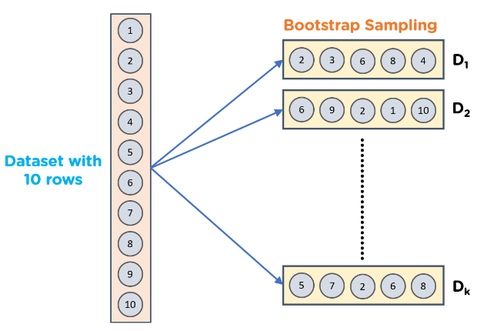
Bootstrapping

Slide 25
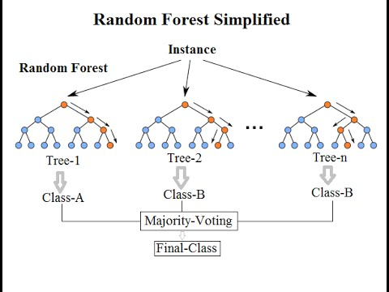

Slide 26
Ensemble method
Multiple individual models are combined to produce an effective optimal prediction model.
The predictions from each tree must have very low correlations.
In RF classifier, the output will be the majority votes of the decision trees
In RF regressor it will be the mean or median of the output of decision trees.

Slide 27
Random Forests vs Decision Trees
Random forests is a set of multiple decision trees.
Deep decision trees may suffer from overfitting, but random forests prevents overfitting by creating trees on random subsets.
Decision trees are computationally faster.
Random forests is difficult to interpret, while a decision tree is easily interpretable and can be converted to rules.

Slide 28
  Reasons for Overfitting are as follows:
  High variance and low bias
  The model is too complex
  The size of the training data
  Avoid Overfit
  Reduce tree depth
  Reduce number of variables sampled each step.
  Use more data.

Slide 29
Applications
Remote sensing
Gaming
Multiple class object detection

